Slide 1
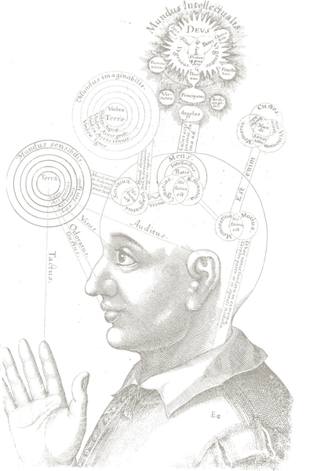
Aspects of consciousness
Except where noted, this work is licensed under a Creative Commons Attribution-ShareAlike 4.0 International License.
1. Conceptions of consciousness
Public domain image
Notes:
http://en.wikipedia.org/wiki/File:RobertFuddBewusstsein17Jh.png

Slide 2
Aspects of consciousness
Religious experience
Pride and Prejudice
Medical
Sleep, dreams
Language use
Access consciousness
Evolutionary fitness
Phenomenal consciousness
Zombies
Soul
Free will
Non-human animals
Computers
Episodic / autobiographical memory
Hypnosis
Meditation
Mindfulness
Notes:
Medical
Phenome

Slide 3
Philosophy
Block, N. (1995). On a confusion about a function of consciousness. Behavioral and Brain Sciences, 18 , 227-287 (prioritise Target Article).
Free will. (2012). Retrieved from http://en.wikipedia.org/wiki/Free will (Online)

Slide 4
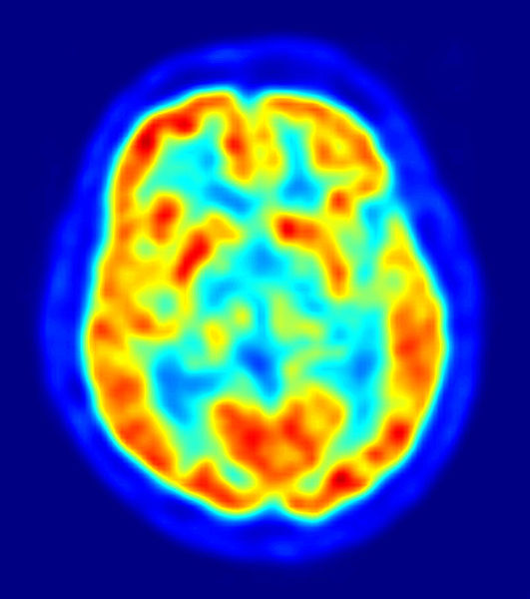

The “explanatory gap”
"How it is that anything so remarkable as a state of consciousness comes about as a result of irritating nervous tissue, is just as unaccountable as the appearance of Djin when Aladdin rubbed his lamp.”
- T.H. Huxley (1866)
Public domain images
Notes:
https://commons.wikimedia.org/wiki/File:Genie_Lamps_2.JPG
https://commons.wikimedia.org/wiki/File:PET-image.jpg

Slide 5
Two types of consciousness
Phenomenal Consciousness
  P-consciousness is experience. We have P-conscious states when we see, smell, hear, taste and have pains.
Access consciousness
  A-consciousness is control. A state is A-conscious if it is available for rational control of action.
The explanatory gap refers principally to P consciousness.

Slide 6
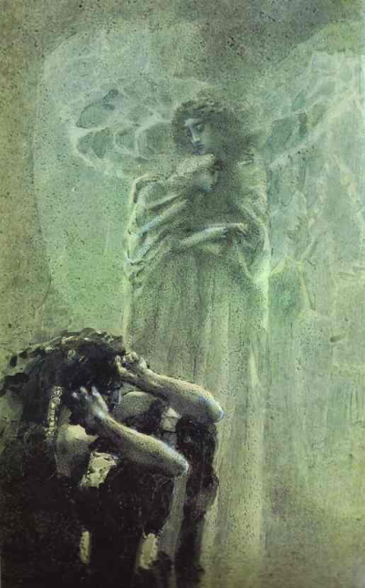
The problem of free will
Laplace’s demon – Imagine an entity who knows the entire history of the universe, and knows all physical laws. This entity could predict the future, including what you will do next. Therefore, you do not have free will.
In other words, if determinism is true, free will is false.
The problem is that most people believe they have free will.
How do we resolve this?
Mikhail Vrubel (1856-1910) - "Demon and angel with Tamara's soul"
Public domain image.
Notes:
https://commons.wikimedia.org/wiki/File:Demon_%26_angel_with_Tamara%27s_soul.png

Slide 7

Answer 1: Theological libertarianism
Determinism is an attribute of the physical world.
The soul is non-physical and hence non -deterministic.
The soul controls our actions.
Hence we have free will
Mind-body problem
  How does the non-physical control the physical? What possible mechanism could there be?
  Is the soul amenable to scientific study?
  If theological libertarianism is true, is this whole course (and psychology in general) rather misguided?
Image: Margret Hofheinz-Döring / Galerie Brigitte Mauch Göppingen
Creative Commons Attribution-Share Alike 3.0 Unported
Notes:
https://commons.wikimedia.org/wiki/File:R%C3%A4tsel_der_Psyche,_Margret_Hofheinz-D%C3%B6ring,_%C3%96l,_1970_(WV-Nr.5010).jpg

Slide 8
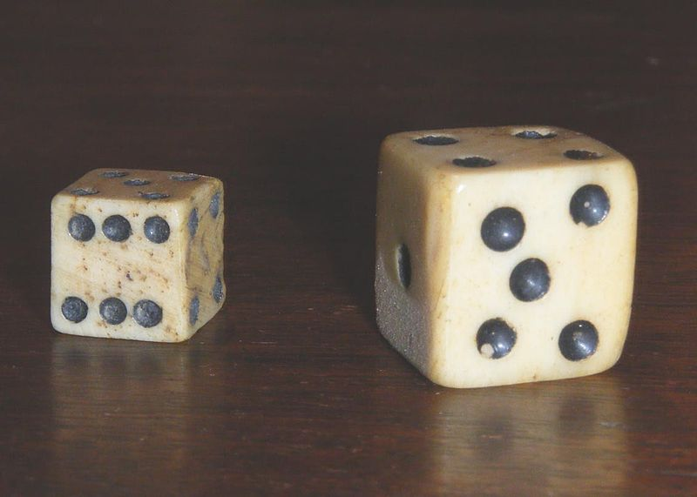
Answer 2: Physical libertarianism
Determinism, plus random chance
  Quantum mechanics.
  Neural noise.
  Issue: Is that really free will? The Dice Man (Luke Rhinehart) as a model of a free agent?
Public domain image
Notes:
https://commons.wikimedia.org/wiki/File:Dadi_antichi.jpg

Slide 9
Answer 3: Determinism is correct
Objections to determinism:
  How can something as dry, simplistic, and reductionist, as deterministic physical laws give rise to something as complex, multifaceted, asethetic, and beautiful, as the behaviour of biological systems?
  Are you serious? We could never predict human behaviour in the way we predict, for example, planetary motion.

Slide 10

Answer 3: Determinism is correct
Answers to these objections:
1. Emergence: Perhaps, free will is an illusion brought on by a lack of understanding of emergent properties
Image: Benjamin Ebel
Creative Commons Attribution-Share Alike 3.0 Unported
http://www.willslab.org.uk/vid/flockofbirds.mp4
http://www.willslab.org.uk/vid/boids.mp4
http://www.vergenet.net/~conrad/boids/
In order to get that last link to work, you may have to change your Java security settings.
Notes:
https://commons.wikimedia.org/wiki/File:Benjamin_Ebel_Birds.jpg

Slide 11
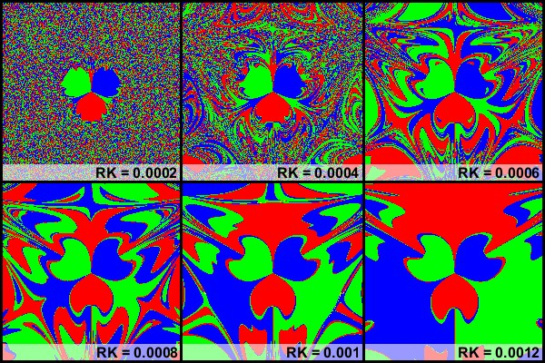
Answer 3: Determinism is correct
  Answers to these objections:
2. Chaos - We can’t predict the weather that well either. Complex systems, like the weather – or even two magnets and a pendulum – are chaotic. This means they are incredibly sensitive to starting conditions. It’s unlikely that we could ever measure starting conditions accurately enough to make deterministic predictions about individual behaviour.
Image and video believed to be in the public domain.
www.willslab.org.uk/vid/magpend1.mp4

Slide 12
Scientific study of consciousness
Consciousness
Perception
Attention
Memory
Action
Blindsight
Meditation
Episodic
Frontal patients
Normal awareness
Hallucinogens
Autonoetic
Drug addiction
Voluntary action
P- consciousness
A- consciousness

Slide 13
Scientific study of consciousness
Consciousness
Perception
Attention
Memory
Action
Blindsight
Meditation
Episodic
Frontal patients
Normal awareness
Hallucinogens
Autonoetic
Drug addiction
Voluntary action
P- consciousness
A- consciousness

Slide 14
Voluntary action
Haggard, P. (2005). Conscious intention and motor cognition. Trends in Cognitive Sciences, 9 , 290-295. [start with this one].
Libet, B., Gleason, C., Wright, E. W., & Pearl, D. K. (1983). Time of conscious intention to act in relation to onset of cerebral activity (readiness-potential). the unconscious initiation of a freely voluntary act. Brain, 106 , 623-642. [classic EEG study].
Lau, H. C., Rogers, R. D., Haggard, P., & Passingham, R. E. (2004). Attention to intention. Science, 303 , 1208-10. [classic fMRI study].

Slide 15
Voluntary action
Q: “What is left over if I subtract the fact that my arm goes up from the fact that I raise my arm?” – Wittgenstein
A: Intention.
Philosophy, and folk psychology, often assume:
Conscious intentions -cause-> actions
Neuroscience rejects this mind-body causation and argues:
Action preparation in frontal and parietal lobes
-causes->
Conscious experience of intending to act

Slide 16
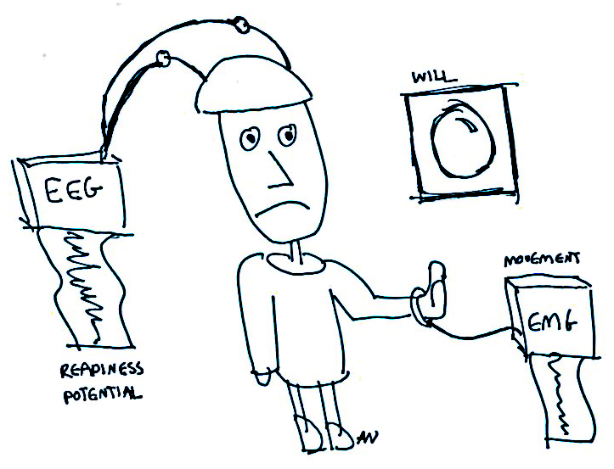
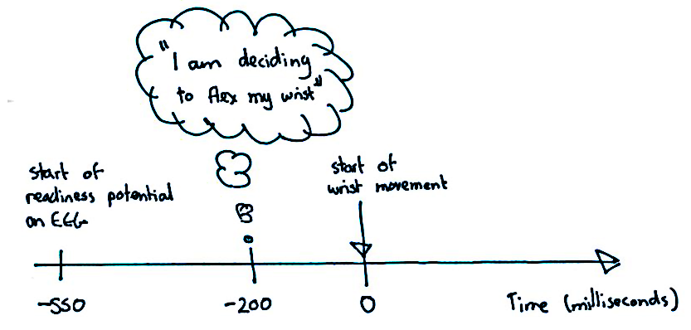
Libet et al. (1983)
The brain starts preparing for the movement about 350ms before the conscious awareness of the intention to move.
Notes:
http://thebrain.mcgill.ca/flash/d/d_12/d_12_s/d_12_s_con/d_12_s_con.html

Slide 17
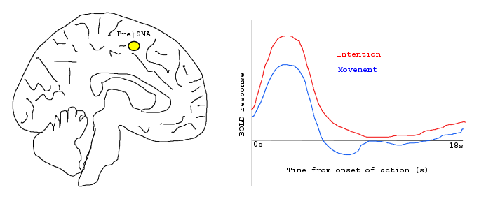
Lau et al. (2004)
Libet’s task in the scanner.
Control condition where participants judge time of motor movement rather than time of intention.
(1) is presumed to enhance the intentional aspects of the task, relative to (2). Subtracting brain activation in the two conditions (1-2; Wittgenstein’s question) should highlight the brain region(s) responsible for the experience of conscious intention.

Slide 18
Correlation does not imply causation
Pre-SMA activity correlates with conscious intention.
The decline in piracy on the high seas correlates with global warming.
Neither relationship is necessarily causal.

Slide 19
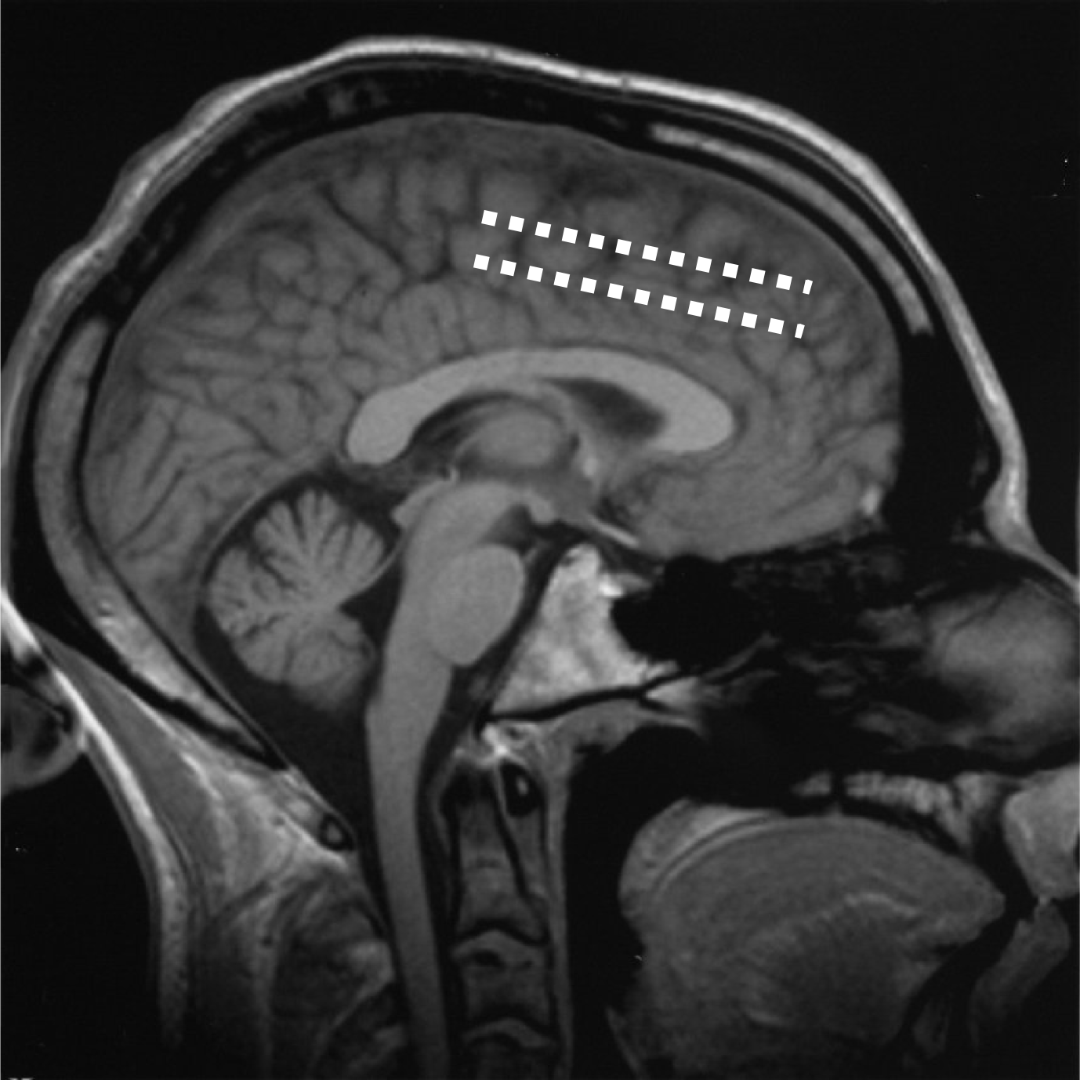
Producing intention and action
Fried et al. (1991)
  Implanted electrodes
  Stimulation leads to reported intention to act.
  Stronger stimulation leads to performance of that action.
Notes:
Picture from Haggard (2005)

Slide 20
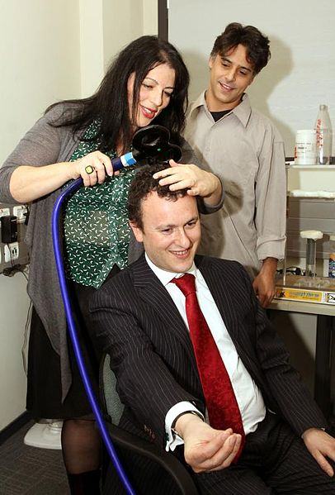
Influencing intention unconsciously
Ammon & Gandevia (1990)
  Participants voluntarily choose to make a left or right response.
  Stimulating with left pre-SMA with TMS increases likelihood of a right response, and vice versa.
  Participants reported no awareness that their actions had been influenced.
Image credit: UK in Israel
Licence: Creative Commons Attribution 2.0 Generic
Notes:
https://commons.wikimedia.org/wiki/File:Ambassador_visits_Bar-Ilan_University_(5287646698).jpg

